Slide 1
PARTIAL DIFFERENTIAL EQUATIONS
Dr. Anirban Tarafdar

Slide 2
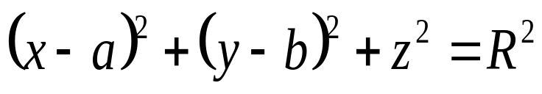
Formation of Partial Differential equations
Partial Differential Equation can be formed either by elimination of arbitrary constants or by the elimination of arbitrary functions from a relation involving three or more variables .
SOLVED PROBLEMS
1.Eliminate two arbitrary constants a and b from
here R is known constant .

Slide 3
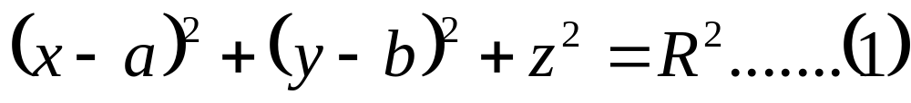
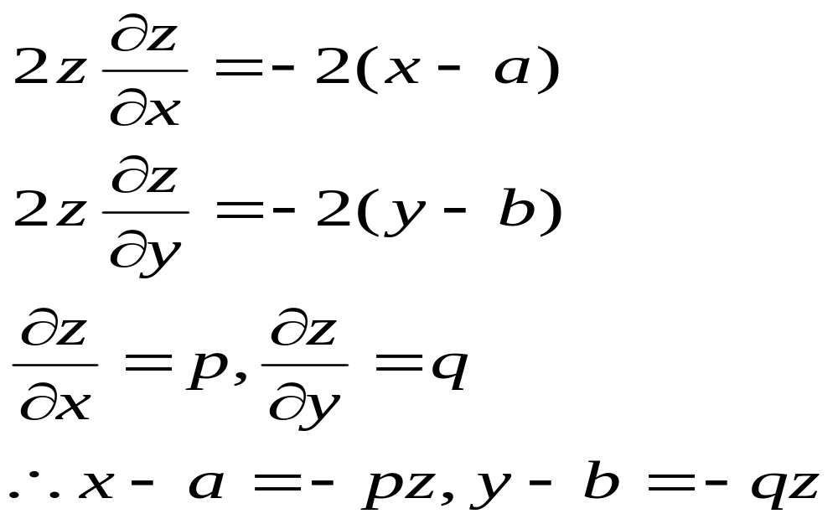
(OR) Find the differential equation of all spheres
of fixed radius having their centers in x y- plane.
solution
Differentiating both sides with respect to x and y

Slide 4
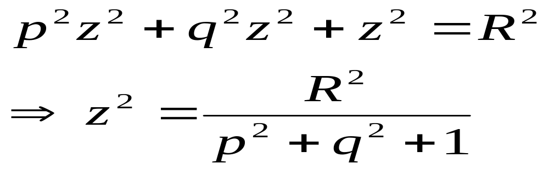
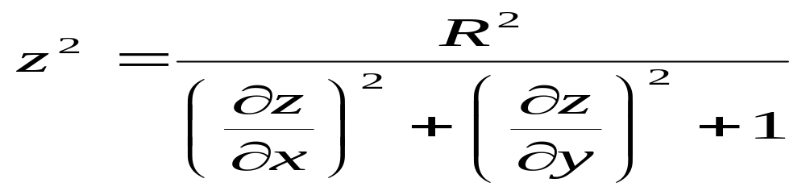
By substituting all these values in (1)
or

Slide 5
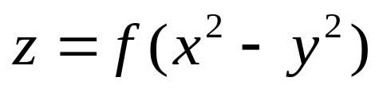
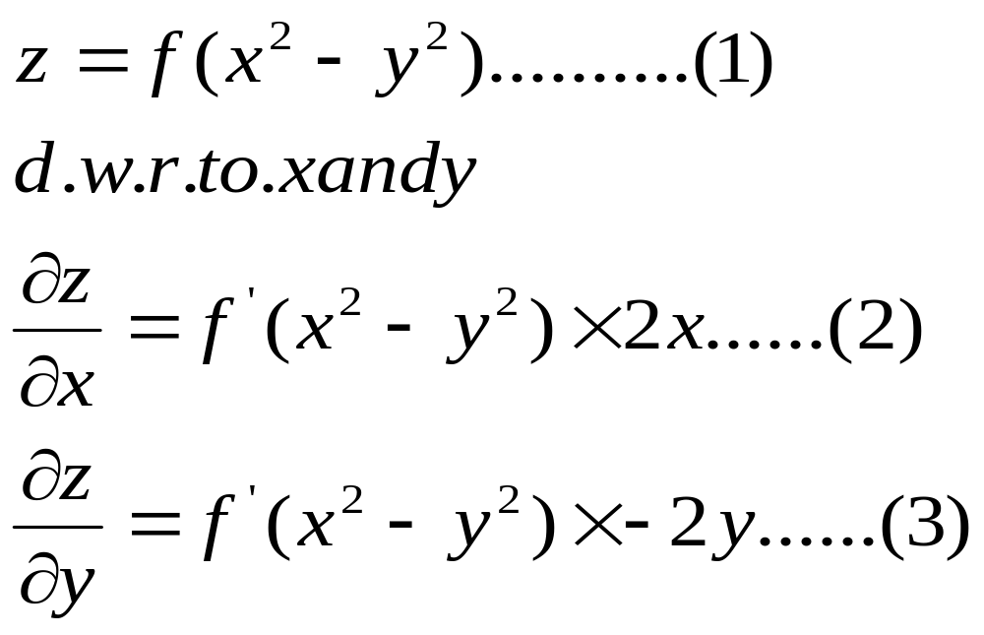
2. Find the partial Differential Equation by eliminating
arbitrary functions from
SOLUTION

Slide 6
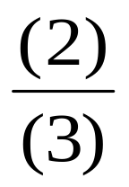
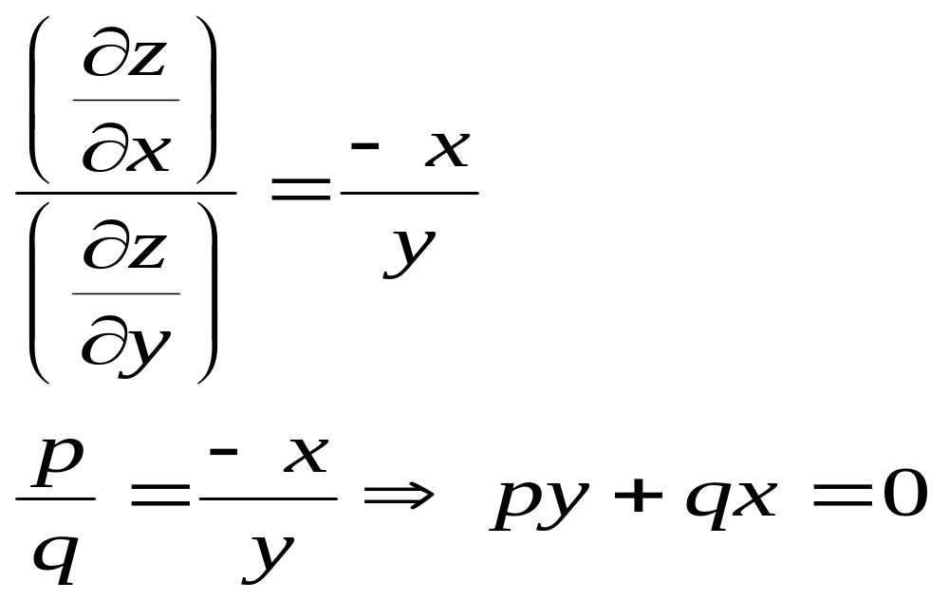
By

Slide 7
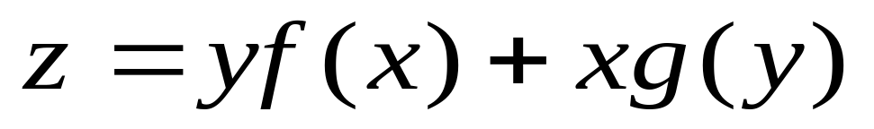
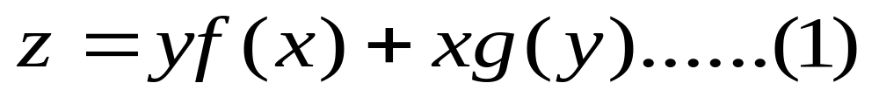
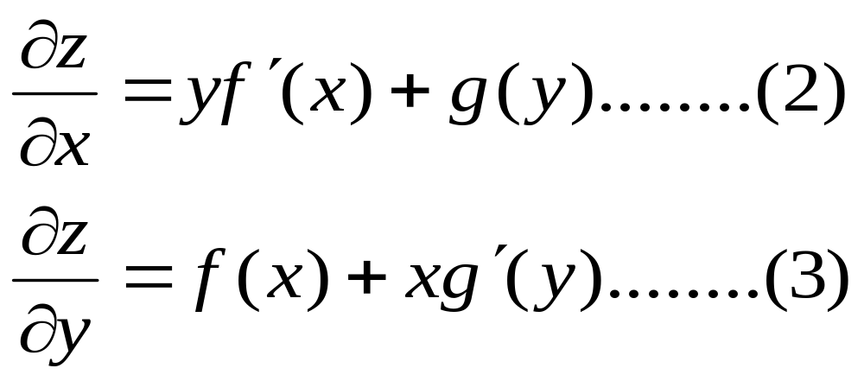
3.Find Partial Differential Equation
by eliminating two arbitrary functions from
SOLUTION
Differentiating both sides with respect to x and y

Slide 8
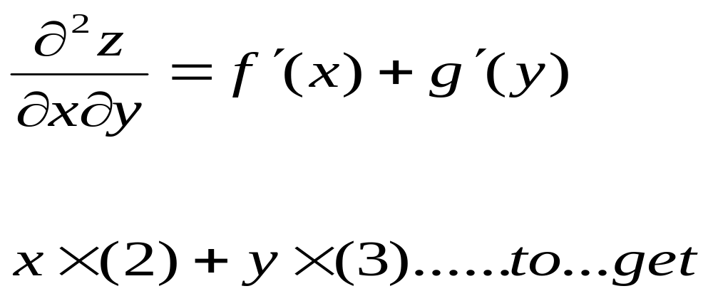
Again d . w .r. to x and yin equation (2)and(3)

Slide 9
